Slide 1
Effects of HEG-neurofeedback on attentional measures in children with neurodevelopmental disorders: a case series study from private practice.
Meinte Vollema, PhD., clinical neuropsychologist
De Binnenkijk, praktijk voor psychotherapie, neuropsychologie en supervisie
Hanengewei 67
3851 LB Ermelo
The Netherlands
meinte@debinnenkijk.nl

Slide 2
What is HEG-neurofeedback?
Questions of this study
Method
Results
Conclusions and some thoughts

Slide 3
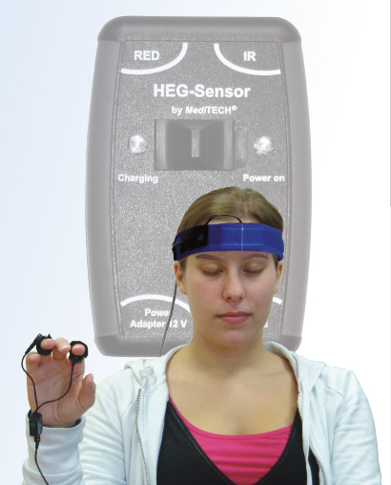
Highlights of HEG-neurofeedback
Not like EEG-neurofeedback based on electrical activity from the brain
But based on hemodynamic variables like blood oxygenation (Near-infrared) and temperature (Passive Infrared)
We used the HEG variant NIRS developed by Herschel Toomin (‘poor man’s fMRI’)
The HEG sensor is placed on the forehead (at Fpz)
Red and Infrared light shine on the brain, the photospectrometer catches
refracted and reflected light
- The main HEG-variable is the red/infrared ratio; red light is absorbed by
oxygenated blood. The higher the ratio, the more oxygenation, the more
regional cerebral blood flow, the more mental activity.

Slide 4
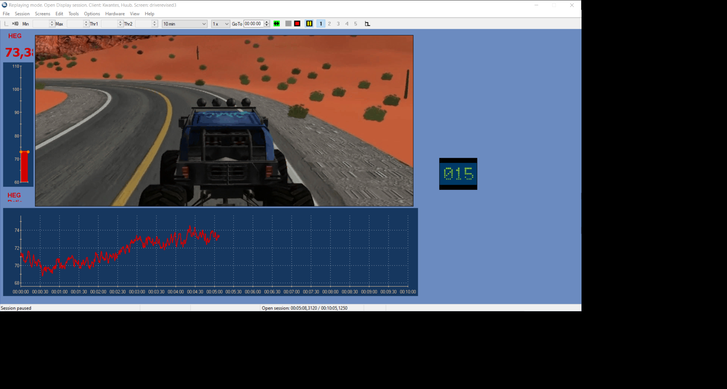
View on patient screen
.

Slide 5
Research on HEG (among other studies)
1) Toomin et al. (2004): children and adults with neuropsychiatric
conditions improved on the TOVA after10 sessions of HEG training
2) Marx et al. (2015) found improvements after 12 sessions of HEG
training in a small group of ADHD-children on ADHD-symptoms and
on attentional measures 4 and 6 weeks after training
3) Barth. et al. (2021): some subjects with ADHD seem to regulate prefrontal brain activity due
to HEG-neurofeedback better than while using EEG-neurofeedback.
4) Westwood et al. (2025): meta-analysis showed no effects of neurofeedback in general on ADHD-
symptoms but on processing speed only.

Slide 6
Questions of this study
Do children with neurodevelopmental disorders and attentional dysfunctions improve their attention after HEG-training?
2) Do we see differences with respect to processing speed, reaction time variability and accuracy?

Slide 7
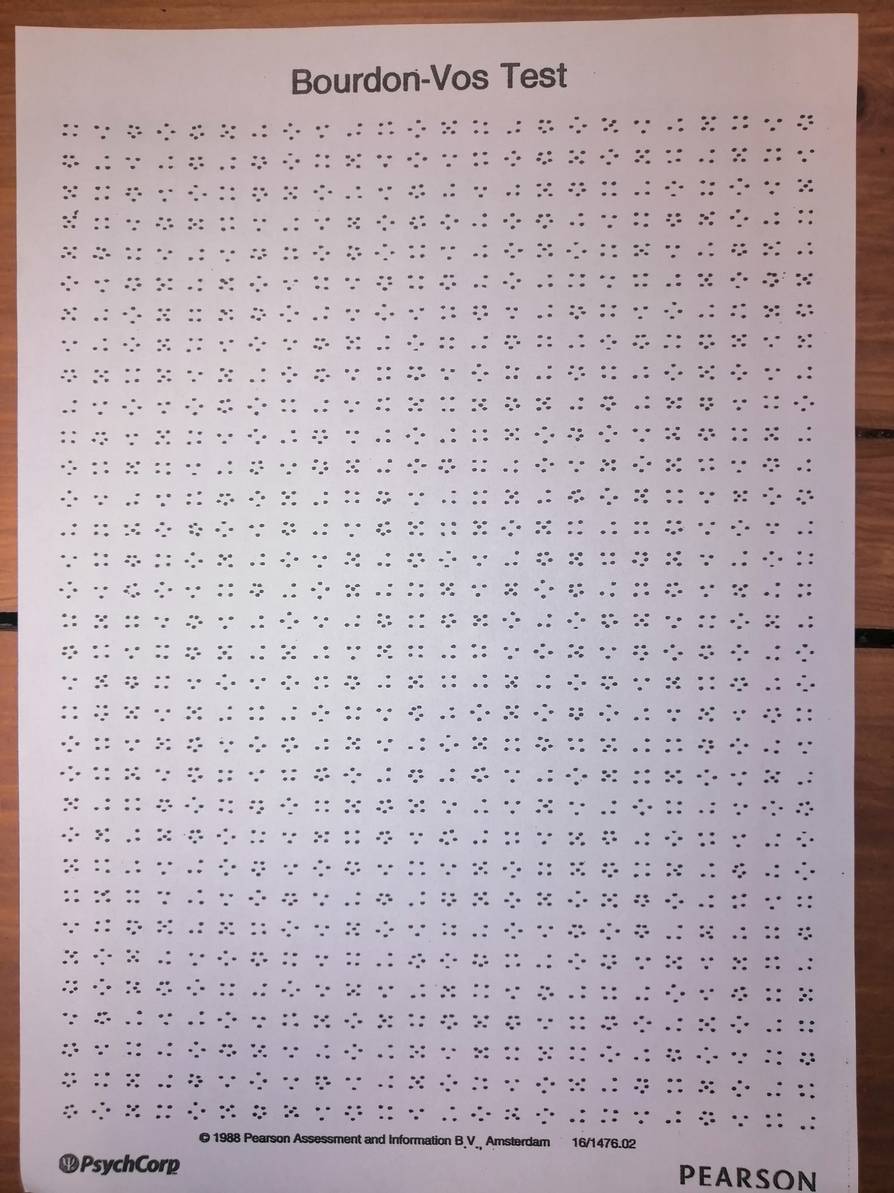
ADHD: high variability in reaction time (Kofler et al. 2013)
Autism spectrum disorder: slow processing speed (Mayes and Calhoun 2008)
Schizophrenia: more omission errors (Elvevag et al. 2000)

Slide 8
Bourdon-Vos test variables (pre- and posttest)
Mean time in seconds of 33 lines: processing speed
Mean of the deviation from the mean: variability in reaction time
Amount of failures (omission/commission errors): accuracy

Slide 9
Intervention: HEG-neurofeedback
* Aim: improving aspects of visual attention
Instruction: try to bring up the curve continuously (learn to regulate brain activity)
11-18 sessions
Sessions of 5 - 20 minutes of duration
Material: HEG-sensor (Meditech), Procomp 2 (2 channel) and Biograph Infiniti (Thought Technology)
Seated behind a pc with HEG-graphics and video on screen
Part of treatment as usual (psycho education,
parent training, selfconfidence training)

Slide 10
Patient characteristics
Subjects | sexe | age | DSM-5 | sessions | medication
R1 | m | 14 | ASD/ADD | 13 | Not anymore
D2 | m | 11 | ASD | 13 | no
M3 | f | 10 | ADHD | 11 | no
S4 | m | 15 | ASD/ADD | 14 | Yes prolonged
J5 | m | 10 | ASD/ADHD | 18 | Yes prolonged
J6 | m | 17 | ASD/ADD | 11 | no
E7 | f | 17 | ASD/ADD | 12 | Not anymore
V8 | f | 13 | ADD | 11 | no

Slide 11
Results: processing speed
Subjects | Pre-test (sec.) | Post-test | Reliable Change Index (RCI)
R1 | 12.5 | 13.1 | -2.31
D2 | 12 | 10.4 | 6.15
M3 | 14.1 | 16.3 | -8.46
S4 | 14 (*) | 12.9 (*) | 4.23
J5 | 13.6 | 11.9 | 6.54
J6 | 10.3 | 9.6 | 2.69
E7 | 9.9 | 8.3 | 6.15
V8 | 17.5 (*) | 16.1(*) | 5.38
* = deviant compared to age-related normgroup

Slide 12
Results: accuracy (total amount of failures)
Subjects | Pre-test | Post-test | RCI
R1 | 42 (*) | 13 (*) | 41
D2 | 13 (*) | 8 | 7.07
M3 | 10 | 0 | 14.14
S4 | 7 | 6 | 1.41
J5 | 16 (*) | 16 (*) | 0
J6 | 6 | 1 | 7.07
E7 | 5 | 5 | 0
V8 | 11 | 5 | 8.49
* = deviant compared to age-related normgroup

Slide 13
Results: variability in reaction time (seconds)
Subjects | Pre-test | Post-test | RCI
R1 | 2.0 (*) | 1.8 (*)
D2 | 1.7 | 1.5
M3 | 3.9 (*) | 2.2
S4 | 1.6 (*) | 1.9 (*)
J5 | 2.5 (*) | 2
J6 | 1.4 (*) | .9
E7 | 1.2 (*) | .9
V8 | 2.3 (*) | 2.4 (*)
* = deviant compared to age-related normgroup

Slide 14

Summary: Difference scores for all patients on three variables

Slide 15
Conclusions
All children showed short term improvements, 2 kids on three variables and 6 kids on two variables
Some differences between variables in favor of accuracy?
Improvements in the expected direction and on an objective measure
Some subjective parent comments
- ‘I saw him reading again’
- ‘She seems to focus a little bit better’

Slide 16
Some thoughts
Improvements exclusively due to HEG neurofeedback?
Placebo and non-specific factors can not be ruled out
RCT was impossible but I could have used a control measure
Anyway stimulating results

